Slide 1
TOPIC 2B Data Structures: TREES

Slide 2
Binary Search Trees
Objective: To access elements in a sorted order
Operations:
Exists: Does an element exist in a set ?
Maximum/Minimum: What is the largest (smallest) element
Insertion
Deletion

Slide 3
Binary Search Trees
For every node, X, in the tree, the values of all the items in its left subtree are smaller than the item in X, and the values of all the items in its right subtree are larger than the item in X.
6
2
8
1
4
3

Slide 4
How to Remove a Node?
What if the node is a leaf?
It can be deleted immediately.
51
51
39
39
20
45
45
49
49

Slide 5
How to Remove a Node?
What if the node has one child?
It can be deleted after its parent adjusts a pointer to bypass the node
51
51
39
39
20
45
30
45
30
49
25
31
49
25
31

Slide 6
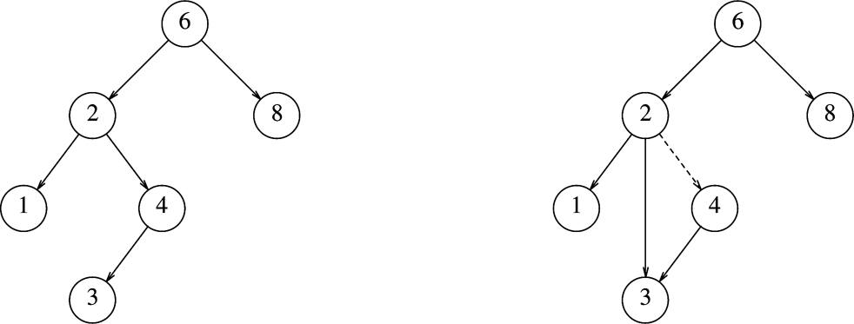
BST: Deletion
Deleting a node with one child
Before delete(4)
After delete(4)
Deletion Strategy: Bypass the node being deleted

Slide 7
How to Remove a Node?
What if the node has two children?
The general strategy is to replace the data of this node with the smallest data of the right subtree, and recursively delete the node.
Find smallest data in right tree
Replace this value in the node
Delete smallest data, since it has no child
6
6
2
8
3
8
1
5
1
5
3
4
4
How about using the left subtree

Slide 8
Lazy Deletion
Another deletion strategy
Don’t delete!
Just mark the node as deleted.
Wastes space
But useful if deletions are rare or space is not a concern.
Even if the number of “deleted” nodes is the same as the number of real nodes, then the height of the tree is only expected to go up by a small constant
If a deleted item is reinserted, the overhead of allocating a new cell is avoided.

Slide 9
Full Binary Tree
Theorem: The number of leaves in a non-empty full binary tree is one more than the number of internal nodes.
Proof (by Mathematical Induction):
Base cases: A full, non-empty binary tree with 0 internal nodes must have 1 leaf node. A full binary tree with 1 internal node must have two leaf nodes.
Induction Hypothesis: Assume any full binary tree T containing n internal nodes has n+1 leaves.
Notes:
This theorem is important, because it helps us to calculate space requirements. It tells us how many nodes are internal and how many are leaf. We need to know this if we have separate implementations for internal and leaf nodes

Slide 10
Full Binary Tree
Induction Step: Given tree T with n internal nodes, pick leaf node L and make it internal (by adding two children). T’ is still full. How many internal leaf nodes does it contain?
We added two new leaf nodes, but lost one
n + 1 + 2 – 1 = n + 2
We created one new internal node
n + 1
T’ has n+1 internal nodes, and n+2 leaf nodes, or n’ internal nodes and n’+1 leaf nodes
By induction, the theorem holds for n >= 0

Slide 11
Binary Search Trees
For every node, X, in the tree, the values of all the items in its left subtree are smaller than the item in X, and the values of all the items in its right subtree are larger than the item in X.
The complexity of most operations on binary search trees are bounded by their heights.

Slide 12
Which one is a binary search tree?
1
6
2
2
8
10
4
6
1
7
10
7
3
9
8
9

Slide 13
A bad binary search tree
Too weak
One balance condition: the left and right subtrees
of the root has the same height.

Slide 14
A perfect binary search tree
Too rigid
Exactly 2^{h+1}-1 nodes
Another balance condition: every node must have
left and right subtrees of the same height.

Slide 15
An AVL Tree
An AVL tree is identical to a binary search tree, except that for every node in the tree, the height of its left and right subtrees can differ by at most 1.
The height of an empty tree is defined to be -1.
The height of an AVL tree is only slightly more than log N.
Therefore, most of the tree operations can be performed in O(log N) time.
It can be shown that the height of an AVL tree is at most roughly 1.44log(N+2)-.328.

Slide 16
Which one is an AVL tree?
7
6
2
8
2
8
1
4
1
4
7
3
6
3

Slide 17
What happens after an insertion?
The balancing information for the nodes on the path from the inserted one back to the root may be changed.
Because only those nodes have their subtrees altered.
We may find a node whose new balance violates the AVL condition.

Slide 18
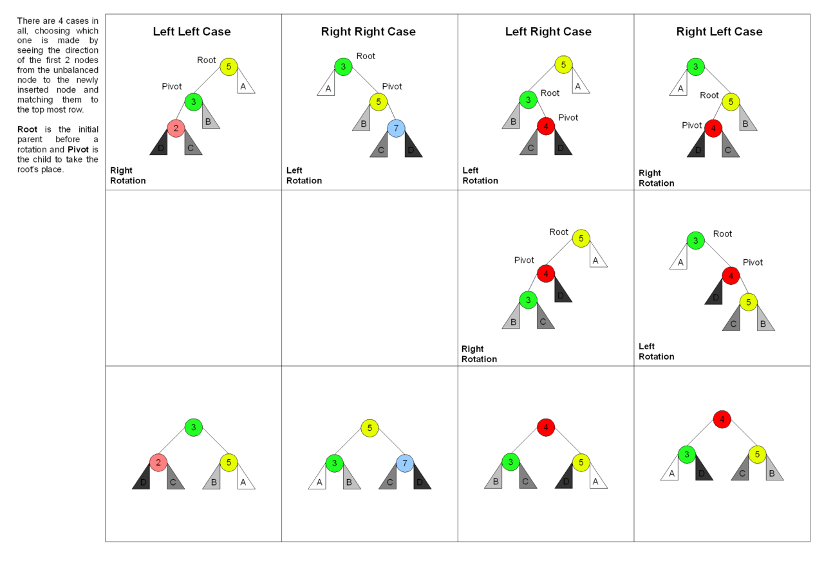
AVL Tree: Balancing
Source: https://medium.com/@randerson112358/avl-trees-a7b4f1fa2d1a
No copyright infringement is intended

Slide 19
An insertion into the left subtree of the left child of α.
1
2
k₂
k₂
0
1
k₁
k₁
Z
Z
X
Y
h-1
Y
h-1
X’
h
h
h
h+1
Before Insertion
After Insertion

Slide 20
Examples (insert 16, 15)
4
4
2
6
2
6
1
3
15
1
3
7
5
5
7
16
16
15

Slide 21
Examples (insert 14)
4
4
2
6
2
6
1
3
15
1
3
7
5
5
7
15
16
14
14
16
First Rotation (Left Rotation)

Slide 22
Examples (insert 14)
4
4
2
6
2
7
6
1
1
15
3
5
7
3
15
5
16
14
14
16
Second Rotation (Right Rotation)

Slide 23
Examples (insert 14)
4
4
2
6
2
7
1
3
15
6
5
1
15
3
7
16
5
16
14
14
Double Rotation (Left + Right)

Slide 24
Summary: Rotations
After inserting a new node with item X into an AVL Tree T, a height imbalance can appear in T.
Left-Left or Right-Right Case
Single Rotation
Left-Right or Right-Left Case
Double Rotation
Rotations are expensive and can occur frequently with insertions.
Can we get O(logN) complexity without balancing the trees ?

Slide 25
Splay Trees
Splay Trees: No bad input
Any M consecutive tree operations take O(MlogN) operations.
However any single operation can take O(N)
Amortized Cost: When a sequence of M operations takes worst case time O(MlogN)
then amortized (average) time is O(MlogN)/M=O(logN)
Main Idea: O(N) operations not bad if they occur infrequently

Slide 26
Basic Ideas
A single operation could take Θ(n) time.
A sequence of “Finds” to deep nodes causes problems.
We change the tree structure after a (bad) operation.
Self-adjusting

Slide 27
Splay Tree
Idea:Self Organizing Binary Search Tree
Use rotations
of move nodes to root
100
32
45
12
100
12
47
45
32
47
When we access a node X, apply a rotation to move the node X closer to root
Repeat until X is the root

Slide 28
First Idea
Bring frequently accessed node closer to the root
For each access bring the accessed node to the root
Perform single rotations until it is the root
Problem: Tree remains unbalanced

Slide 29
Splaying at node A
C
A
C
A
y
y
B
⇒
B
C
B
B
v
⇒
v
A
v
w
x
y
A
x
w
C
y
w
x
v
w
x
2. zig-zag
1. One side
B
A
A
z
⇒
x
B
x
y
y
z
3. No grandparent

Slide 30
INSERTION
Insert new node as leaf in correct position
Splay new node until it becomes the root

Slide 31
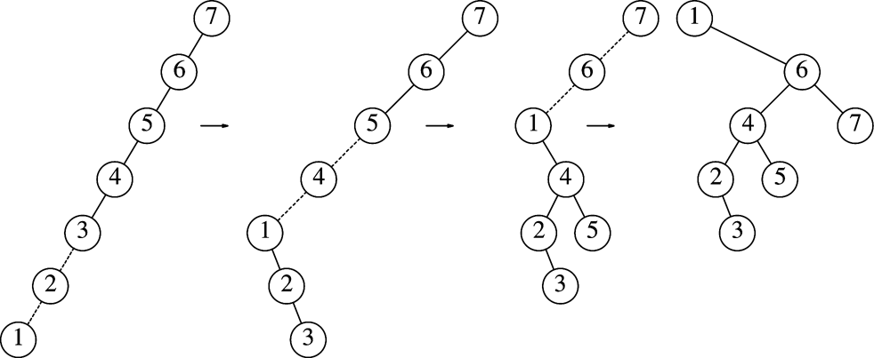
Example: Inserting Node 1
Figure 4.49: Result of splaying at node 1
For more Examples: https://www.cs.usfca.edu/~galles/visualization/SplayTree.html

Slide 32
Insert 5
7
7
7
5
3
8
3
8
3
8
3
7
1
4
1
4
1
5
1
4
6
8
2
6
2
6
2
4
6
2
5
Insert
Splay

Slide 33
Delete
Depends on how often deletions are…
Delete X
1. First Splay X
2. Splay the largest node A in the left subtree upto root of left subtree
3. Delete X
4. Make A new Root

Slide 34
Delete
delete(4)
Start
After splay(3)
After splay(4,T)
4
7
4
6
3
6
2
6
7
2
5
5
1
3
5
7
1
2
3
1
4
2
6
3
1
5
7
After delete 4 and reset left link of 3

Slide 35
Amortized cost for splay tree
For a splay tree, the worst case cost for a sequence of M operations starting from an empty tree is bounded by O(MlogN)
Thus, amortized cost per operation is logN
Worst case running time for an operation is O(N)
Cost of O(N) for an operation is not bad for many applications if this happens seldom. In binary search tree a sequence of worst case operations can happen

Slide 36
Memory Access
Data Locality can affect performance time
Data is accessed from hard drive via cache
Data in cache can be accessed faster….
Line of 64 bytes in 2.5 ns
…than Data in main memory
First word (4 bytes) 50 ns and then 5ns for consecutive words
Unless data is carefully arranged, memory access will dominate running time.

Slide 37
Using Binary Search Tree
Binary search Trees
The worst case: linear time 10,000,000 disk accesses.
In a typical randomly constructed tree, a search would require about 100 disk accesses.
AVL Trees
The worst case of 1.44 log N (≈ 35 disk accesses, )
The typical case using an AVL tree is very close to log 10,000,000 ≈ 24 disk accesses

Slide 38
How to reduce the number of disk accesses?
Consider each height as a disk access
Reduce the number of disk accesses
We cannot go below log N using a binary search tree (including AVL tree).
A binary search tree allows only one key per node.
The only way to reduce the number of disk accesses is to increase the number of keys in a node.

Slide 39
More Branching=Less Height
An M-ary search tree allows M-way branching.
A perfect M-ary tree is an M-ary search tree with all the leaf nodes at the same depth.
A complete M-ary tree has height that is roughly log_{M}N

Slide 40
A binary tree of 31 nodes has five levels
5-ary tree of 31 nodes has only three levels

Slide 41
M-ary Search Tree
In an M-ary search tree, we need M-1 keys to decide which branch to take.
Should be balanced in some way.
We do not want an M-ary search tree to degenerate to even a binary search tree.
Root
k_{m} k_{n} k_{o} k_{p}
<k_{m}
≥ k_{m}, < k_{n}
≥ k_{n}, < k_{o}
≥ k_{o}, < k_{p}
≥ k_{p}

Slide 42
Example
Root
13 17 25
k<13
13≤k<17
2 9 10 11
13 15
17 19 22
25 28 33

Slide 43
B-tree
A B-tree of order M is an M-ary tree with the following properties:
The data items are stored at leaves.
The nonleaf nodes store up to M-1 keys to guide the searching; key i represents the smallest key in subtree i+1.
The root is either a leaf or has between two and M children.
All nonleaf nodes (except the root) have between ⎡M/2⎤ and M children.
All leaves are at the same depth and have between ⎡L/2⎤ and L children, for some L.

Slide 44
B-tree of order 5
41
66
87
8
18
26
35
48
51
54
72
78
83
92
97
2
4
6
8
10
12
14
16
18
20
22
24
26
28
30
31
32
35
36
37
38
39
41
42
44
46
48
49
50
51
52
53
54
56
58
59
66
68
69
70
72
73
74
76
78
79
81
83
84
85
87
89
90
92
93
95
97
98
99
Leaf nodes are in sorted two-way linked list

Slide 45
Insertion
If empty we create one node that is a root node and insert there - otherwise -
Find the node the key belongs in
Insert if enough room - otherwise -
Split in half into two nodes
Insert new key (median value from node that was plit) in parent recursively

Slide 46
Example - Insert 16 & 3
Root
13 -- --
Insert 3
Insert 16
3
2 9 10 11
13 15
13 15 16

Slide 47
Split a node
Root
13 -- --
9
“pushed up”
2 3
9 10 11
13 15 16

Slide 48
Insert continued
Root
9 13 --
2 3
9 10 11
13 15 16

Slide 49
Add item 57 to the B-Tree
41
66
87
8
18
26
35
48
51
54
72
78
83
92
97
8
10
12
14
16
18
20
22
24
26
28
30
31
32
35
36
37
38
39
41
42
44
46
54
56
57
58
59
2
4
6
48
49
50
51
52
53
54
56
58
59
66
68
69
70
72
73
74
76
78
79
81
83
84
85
87
89
90
92
93
95
97
98
99
Add item 55

Slide 50
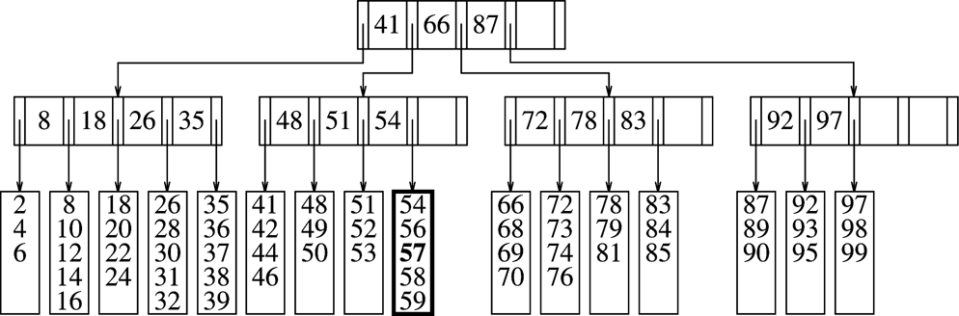
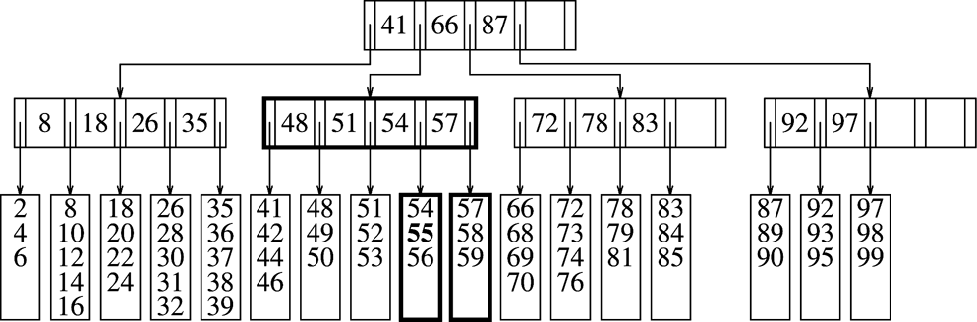
Add item 55

Slide 51
Exercise: Add 40
41
66
87
8
18
26
35
48
51
54
57
72
78
83
92
97
2
4
6
8
10
12
14
16
18
20
22
24
26
28
30
31
32
35
36
37
38
39
41
42
44
46
48
49
50
51
52
53
54
55
56
57
58
59
66
68
69
70
72
73
74
76
78
79
81
83
84
85
87
89
90
92
93
95
97
98
99

Slide 52
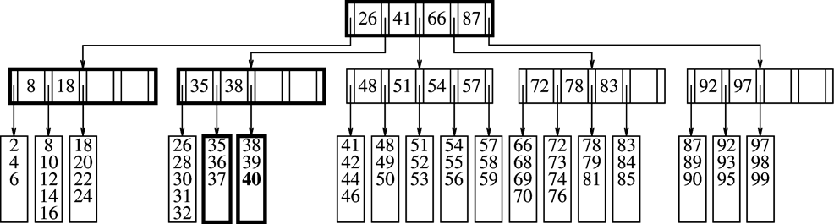
Add item 40

Slide 53
Remove an item from B-Tree
What if the leaf it was in has the minimum number of data items?
Adopting a neighboring item if the neighbor is not itself at its minimum.
If neighbor at minimum combine with the neighbor to form a full leaf.
This means that the parent has lost a child. If parent to fall below its minimum, follow the same strategy.

Slide 54
Remove item 99 from the B-Tree
41
66
87
8
18
26
35
48
51
54
72
78
83
92
97
2
4
6
8
10
12
14
16
18
20
22
24
26
28
30
31
32
35
36
37
38
39
41
42
44
46
48
49
50
51
52
53
54
56
58
59
66
68
69
70
72
73
74
76
78
79
81
83
84
85
87
89
90
92
93
95
97
98
99

Slide 55
After removing 99 from the B-Tree
41
66
83
8
18
26
35
48
51
54
72
78
87
92
2
4
6
8
10
12
14
16
18
20
22
24
26
28
30
31
32
35
36
37
38
39
41
42
44
46
48
49
50
51
52
53
54
56
58
59
66
68
69
70
72
73
74
76
78
79
81
83
84
85
87
89
90
92
93
95
97
98

Slide 56
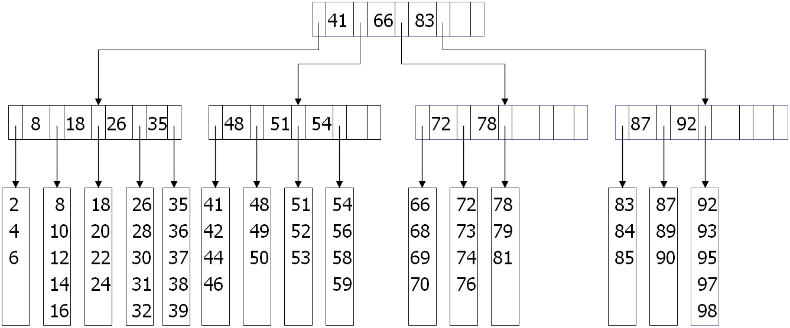
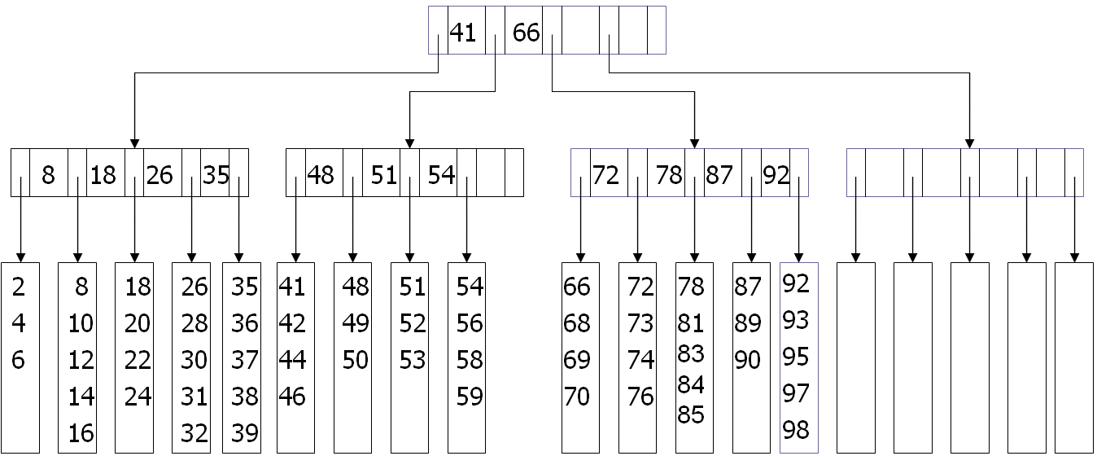
Exercise: Remove item 79

Slide 57
228-Ary B-Tree
228-Ary B-tree M=228
The size of the leaf-node is 32 records. L=32
Each leaf has between 16 and 32 data records, so there are, at most, 10,000,000/16 ≈ 625,000 leaves.
Each internal node (except the root) branches at least 114 ways.
In the worst case, leaves would be on level 4
Complete M-ary tree has height log_{M}N
Average height = log_{M/2}N

Slide 58
Using B-Tree
Each node represents a disk block.
Choose M and L based on the size of the items that are being stored.
Suppose one block holds 8,192 bytes.
In our example, each key uses 32 bytes.
Let each branch link is 4 bytes.
Total memory requirement for a nonleaf node is thus (32(M-1) + 4M)).
What is the maximum value of M?
Each record is 256 bytes, what is the largest value of L?

Slide 59
Summary for B-trees
Binary Search Trees
Complexity O(logN) if balanced
Balancing too often is expensive
Splay Trees
Amortized cost is O(MlogN)
Worst case O(N)
B-Trees
B-trees are balanced M-way (as opposed to 2-way or binary) trees, which are well suited for disks.
Tree height increases at top, not bottom
Tree is inherently balanced.
More complicated to implement

